Slide 1
Elements of Art: Value
By: Mr. Bush

Slide 2
What is “Value” in art?
The term “value” is used in the language of art to refer to the quality of light. The more light, the higher the value. White is the highest or lightest value. On the other hand , black is the lowest or darkest value. Colors have value as well. Yellow for example has a relatively high (light) value, while violet has a relatively low value (dark).

Slide 3
Significance of Value
Value is very important to art because value changes are what creates “contrast.” Contrast is needed to help us see and understand a two dimensional (2-D) work of art. For example, if there was no value contrast between the words on this page and the background; you would have difficulty reading what is here.

Slide 4
Significance of Value
Value contrasts can also create interest in art works. Our eyes tend to be drawn to areas of high contrast, so artists use this to show us what they think is important.

Slide 5
Value Scales
Values scales are charts that demonstrate the changing values of a tone. A typical value scale has incremental steps running from dark to light or vice versa. A scale may also be a continuous gradient of tones; where the change is blended and tonal steps are not visible. Here are example of both types.

Slide 6
Value Scales

Slide 7
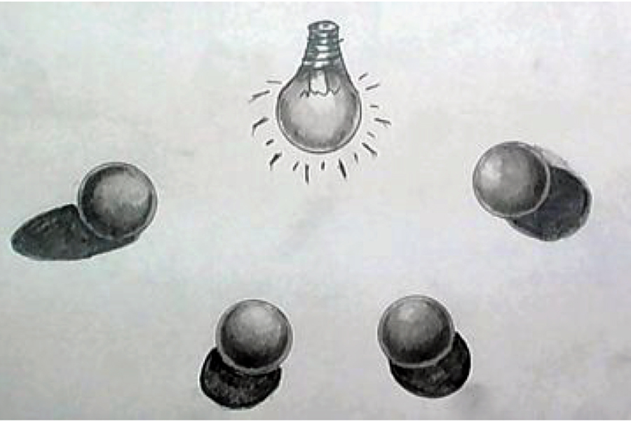
Types of Value Drawing

Slide 8
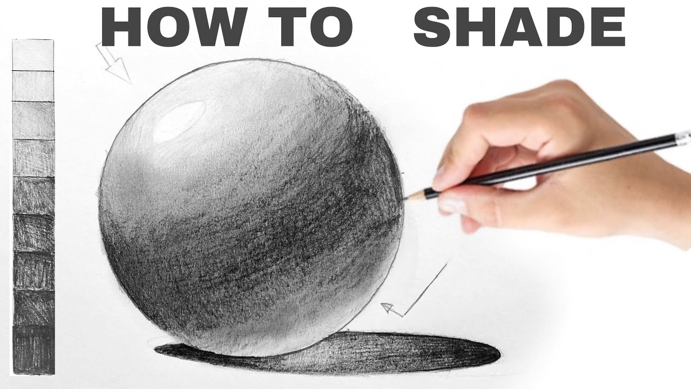
Types of Value Drawing

Slide 9
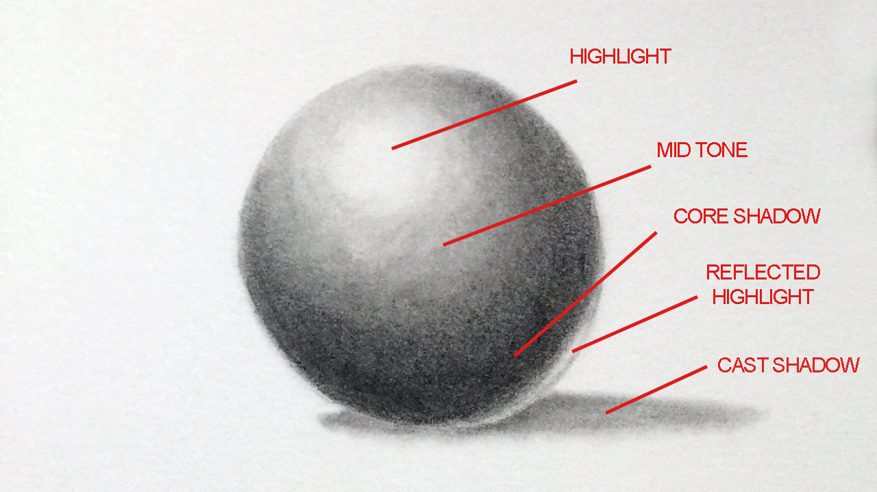
Types of Value Drawing

Slide 10
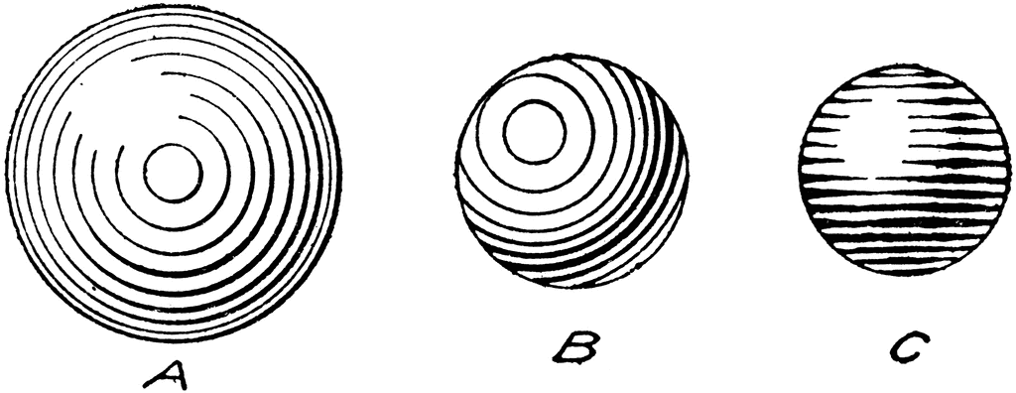
Types of Value Drawing

Slide 11
Types of Value Drawing

Slide 12
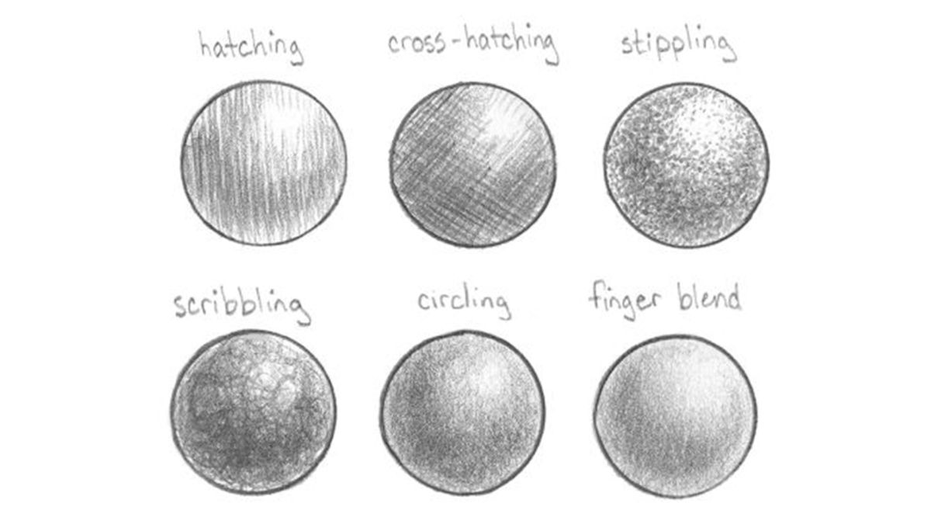
Types of Value Drawing

Slide 13
Monochromatic
A monochromatic painting is one created using only one color or hue. While the shades of the color can be different, the painting contains only one main base color. Limiting oneself to a single color, can spark this same kind of creativity and encourage an artist to explore other intriguing design elements.

Slide 14
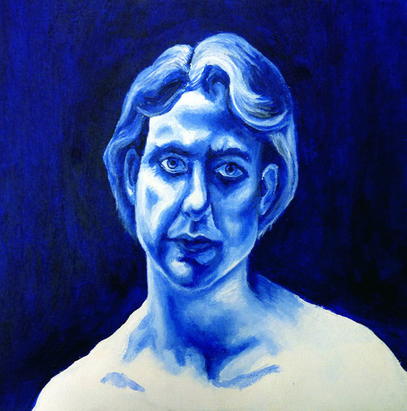
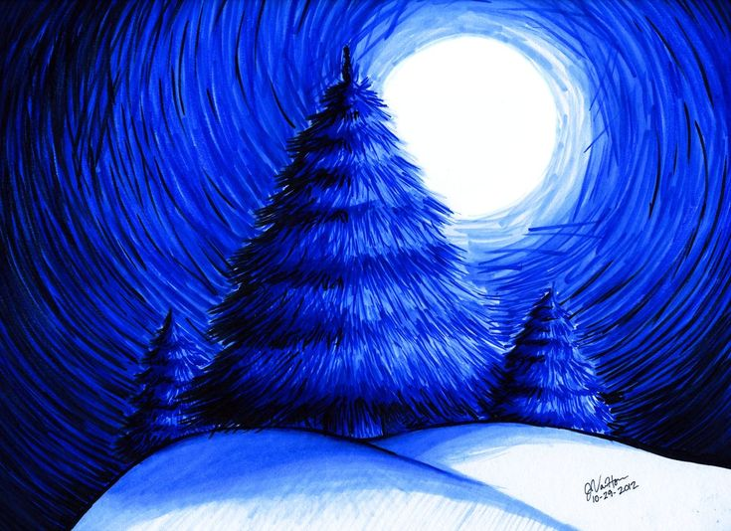
Monochromatic

Slide 15
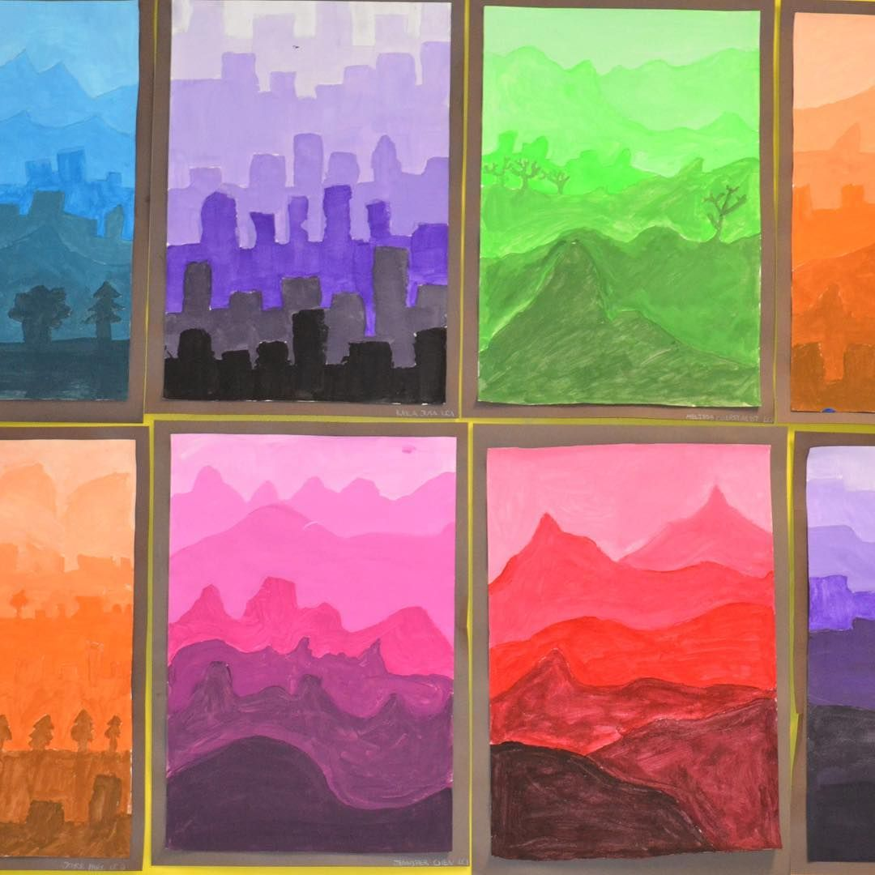
Atmospheric Perspective

Slide 16
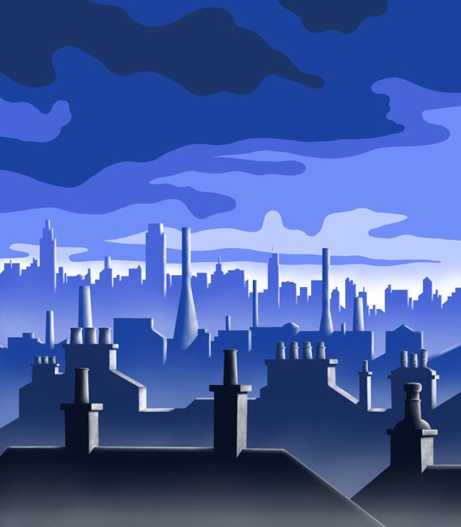
Atmospheric Perspective

Slide 17
Monochromatic

