Slide 1
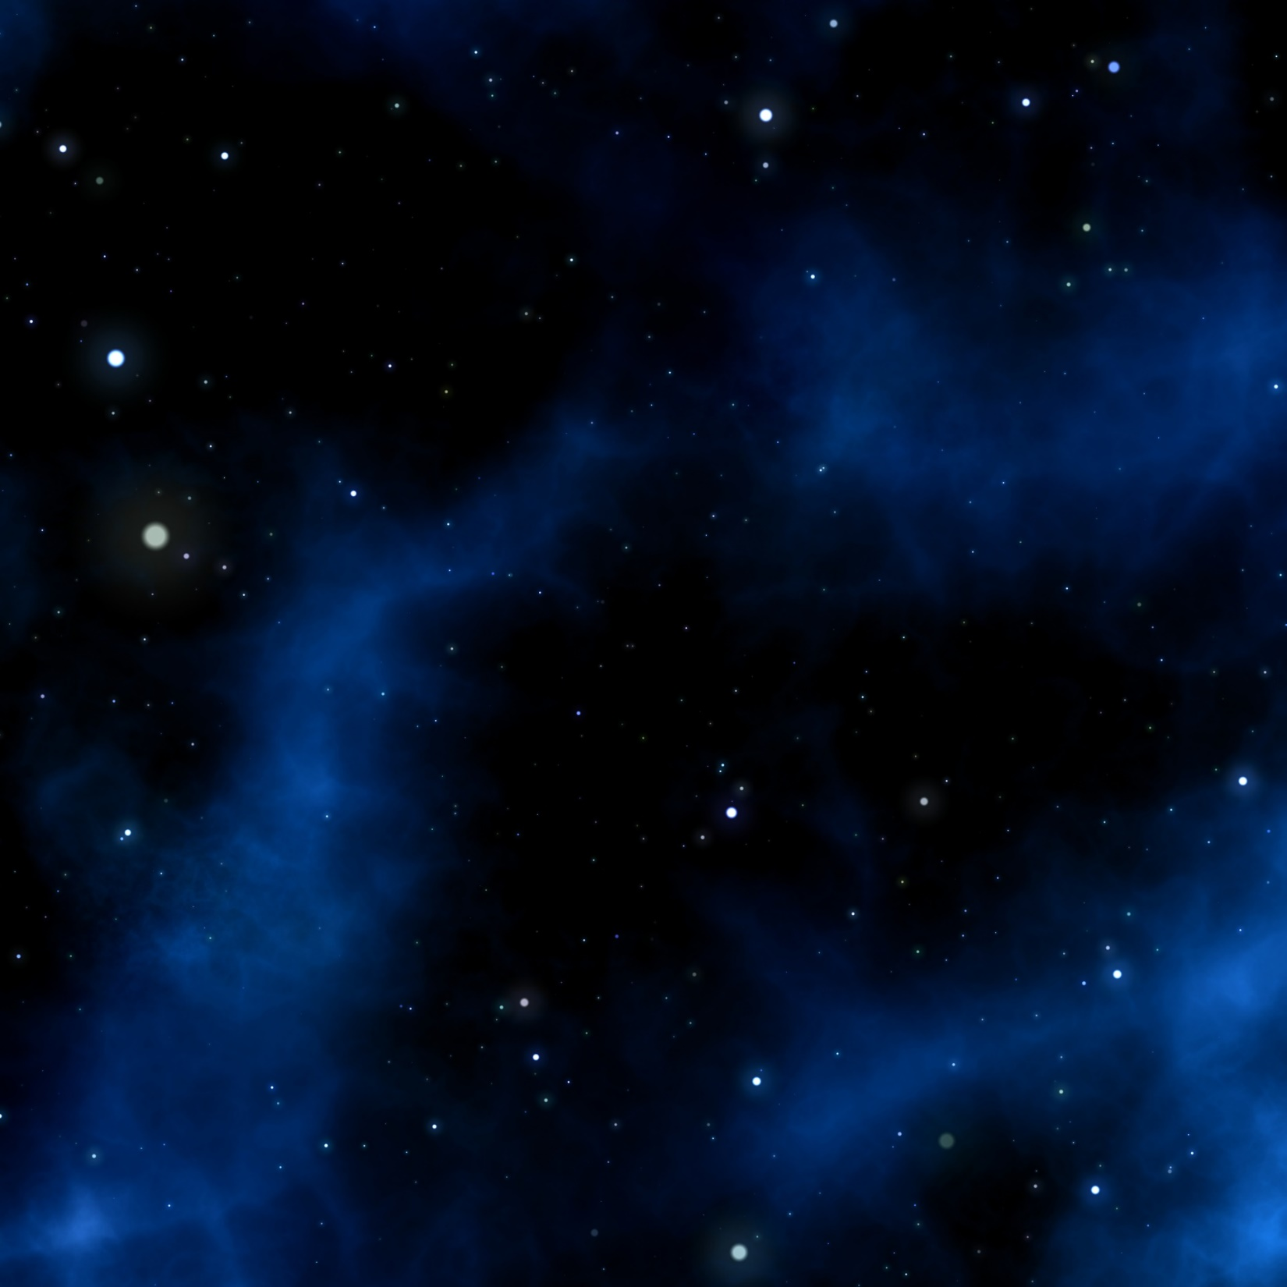
Elements of art: space
By: mr. bush

Slide 2
What is “space” in art?
Design “space” refers to the area within, around, above or below an object or objects. It is important to creating and understanding both two dimensional (2-D) or three dimensional (3-D) works of art. With 3-D art, the space things occupy is real as is the space around object. 2-D art exists on a flat surface, so if something looks three dimensional- it is an illusion. Even the most realistic paintings or photographs are illusions. 2-D artists use a number of "tricks" for creating the illusion of depth in their art.

Slide 3
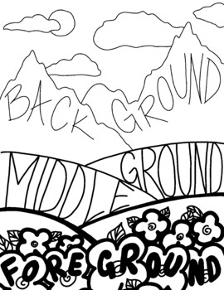
The illusion of space

Slide 4
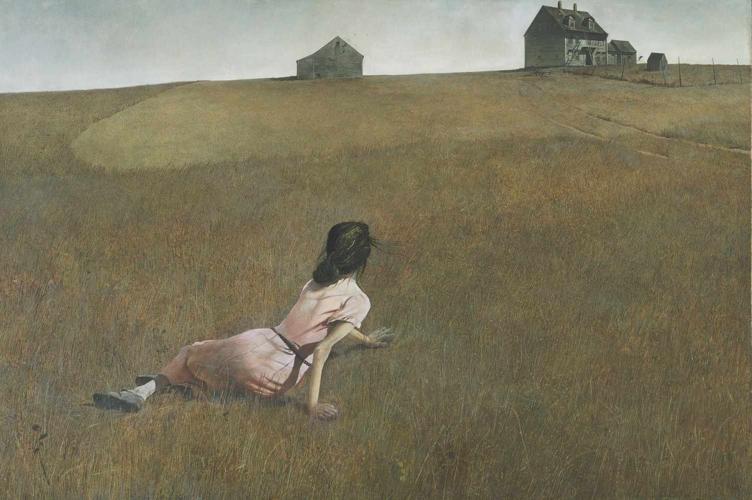
The illusion of space
Size: larger objects appear closer, smaller further away

Slide 5
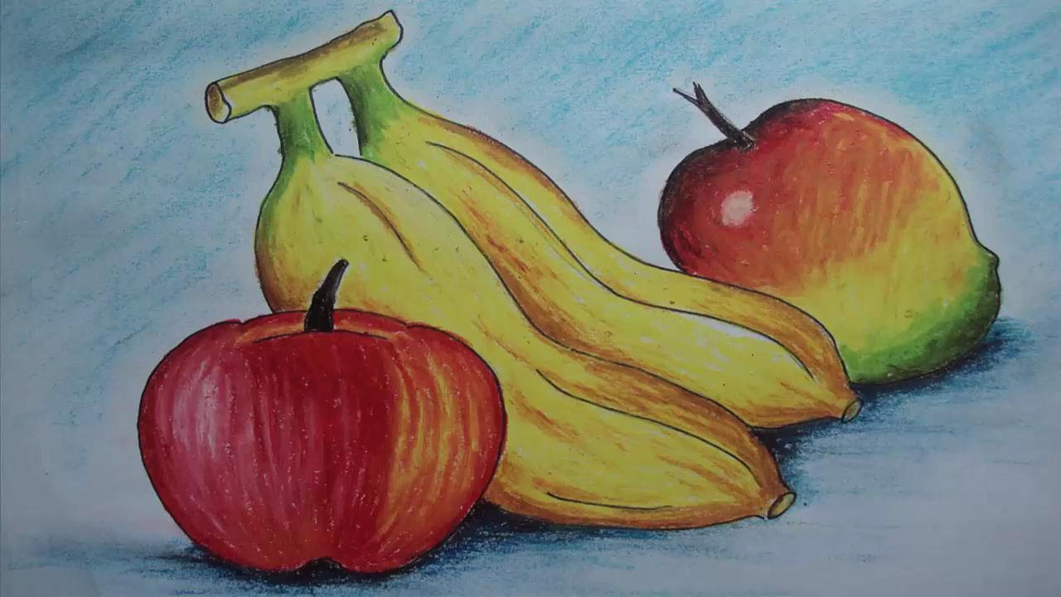
The illusion of space
Overlap: partially covering one shape or object with another makes the one in front appear closer.
Overlap may also divide objects into categories of foreground, middle ground, and background.

Slide 6
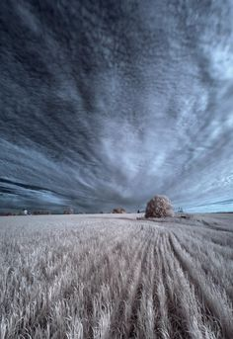
The illusion of space
Placement: where a shape or object is in relationship to the horizon line creates depth. Things closer to the horizon line appear further away. Objects closer to the bottom or top of your paper (canvas, etc.) appear closer.

Slide 7
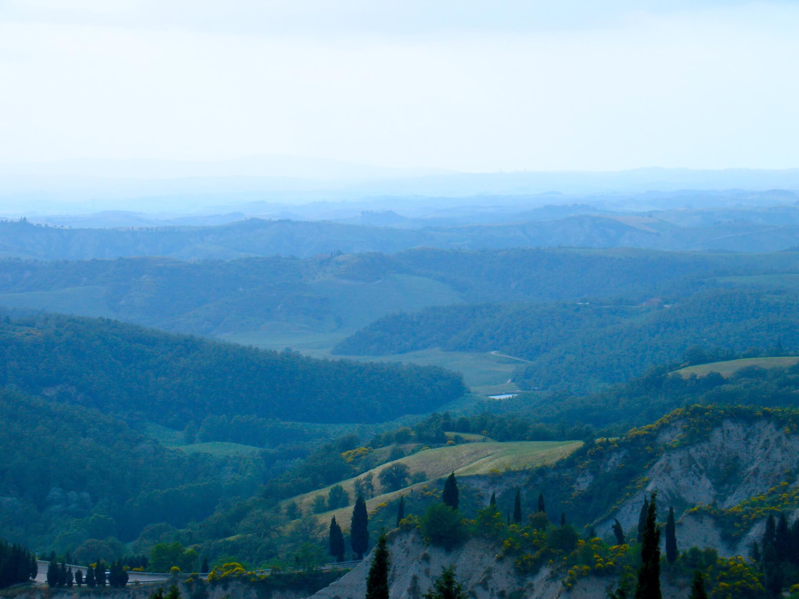
The illusion of space
Atmospheric perspective: objects as they recede into the distance begin to lose color brightness and detail.

Slide 8
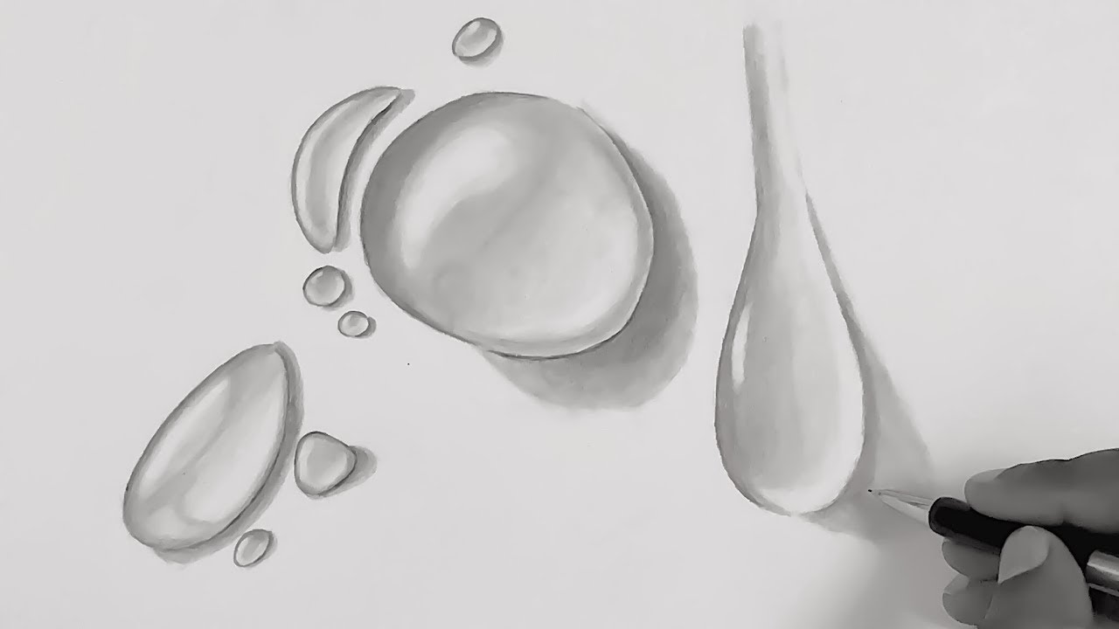
The illusion of space
Shading: adding light and shadow to the surface of objects to mimic the way real objects would appear under the same lighting.

Slide 9
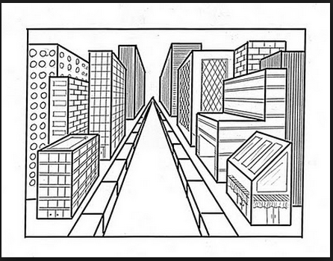
The illusion of space
Linear Perspective: this is a system of drawing developed during the Renaissance period of history (about 1400-1500). It use lines that converge on vanishing points to achieve a more realistic illusion of space. Linear perspective is described by the number of vanishing points used- one point, two point, and/or three point perspective. When multiple are used, they made a very complex image.
One Point

Slide 10
The illusion of space
One Point

Slide 11
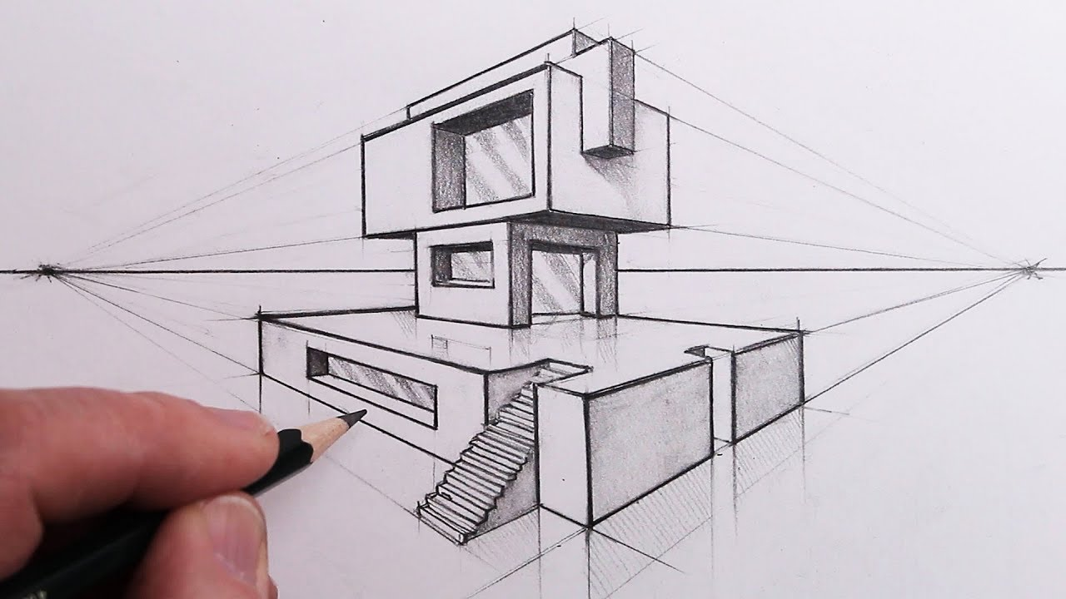
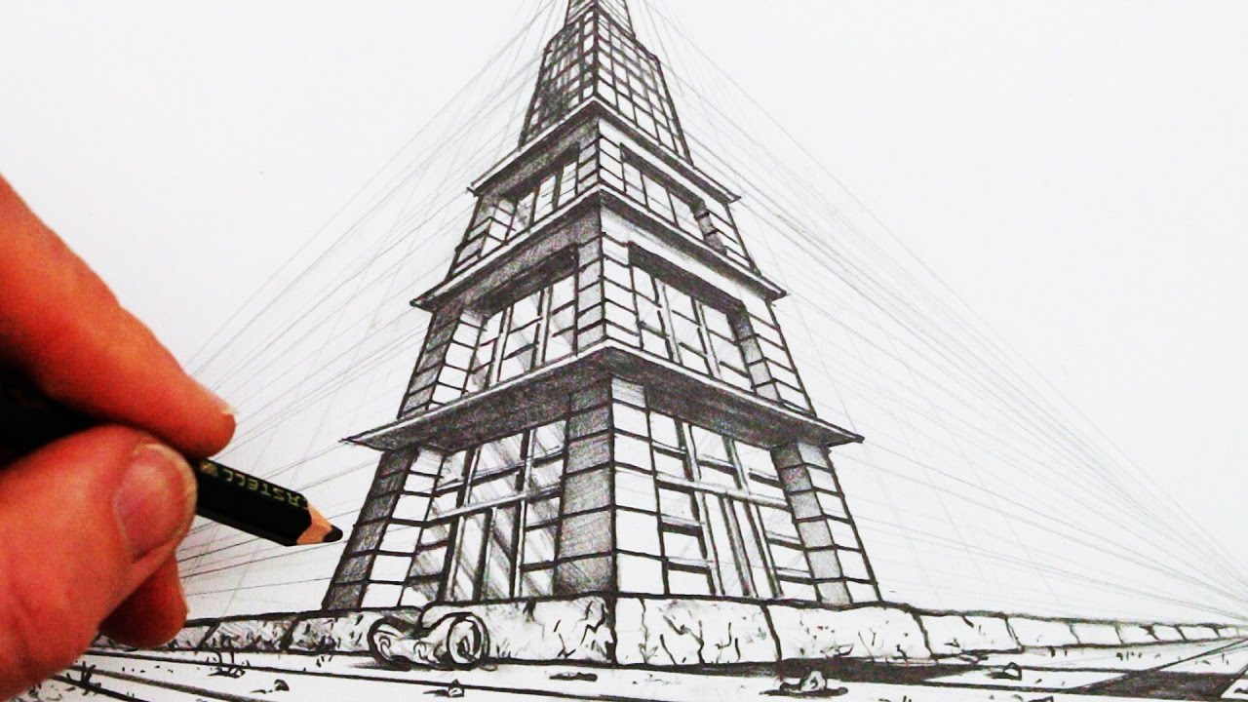
The illusion of space
Two Point Perspective
Three Point Perspective

Slide 12
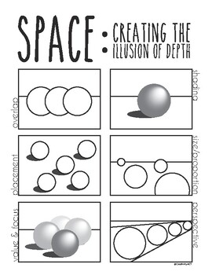
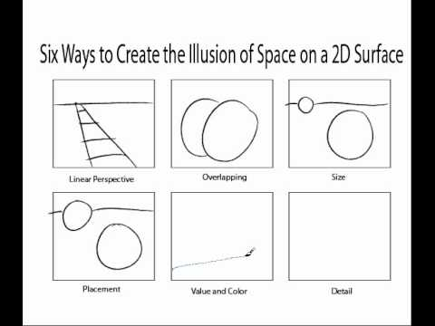
The illusion of space

