Slide 1
Elements of Art: SHAPE
By: mr. bush

Slide 2
What is a “shape?”
Shape: is a two dimensional (2-D) FLAT area confined by a actual line or implied line (an edge for example). In drawing shapes are created when the ends of lines are joined to enclose areas.

Slide 3
Types of Shapes
There are two general types that are used to describe shapes:
Geometric
Free-Form or Organic Shapes

Slide 4
Geometric Shapes
Can be described using mathematical terms
They are very regular or precise
They are more often found in man-made things because they are easier to reproduce and make things with
Examples of geometric shapes are: squares, rectangles, triangles, circles, oval, pentagons and so on.

Slide 5
Geometric Shapes

Slide 6
Free-form or Organic Shapes
are irregular or uneven
are more often found in nature
examples could include the shape of clouds, mountains, trees, lakes, rocks and so on

Slide 7
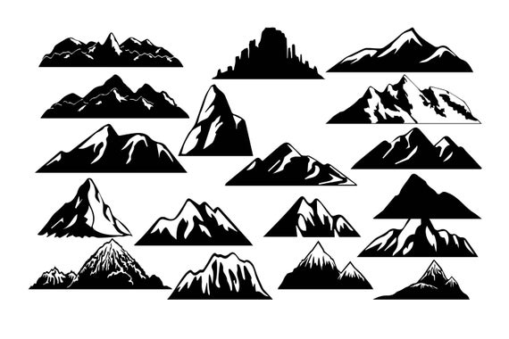
Free-form or Organic Shapes

Slide 8
Positive and Negative Shapes
In most forms of art shapes may be considered positive or negative depending on how they are used. Positive shapes are usually those which are the subject matter within a work of art. Negative shapes (or space) are those in the background or around the positive shapes. By viewing images as silhouettes, it is easier to understand what the positive shapes and the negative shapes are.

Slide 9
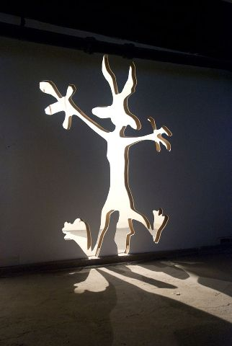
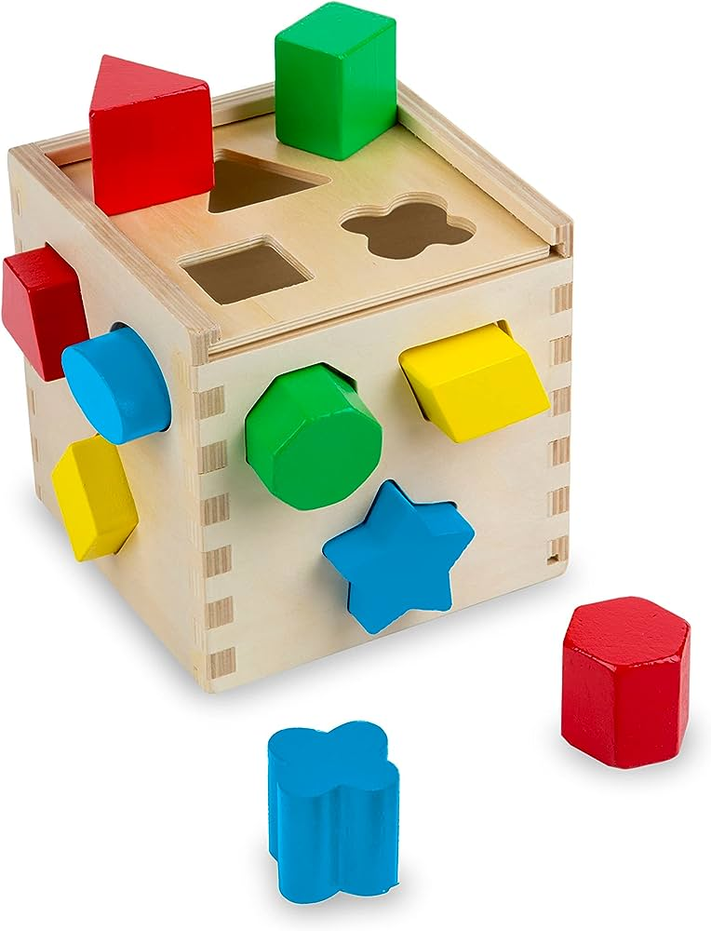
Positive and Negative Shapes

Slide 10
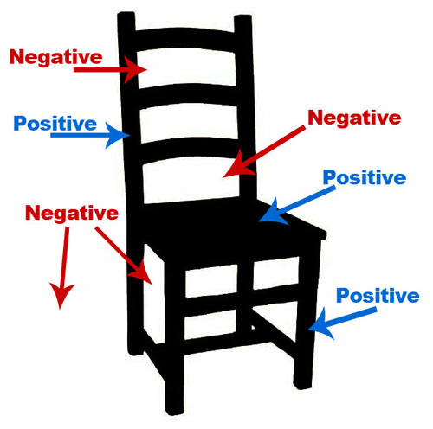
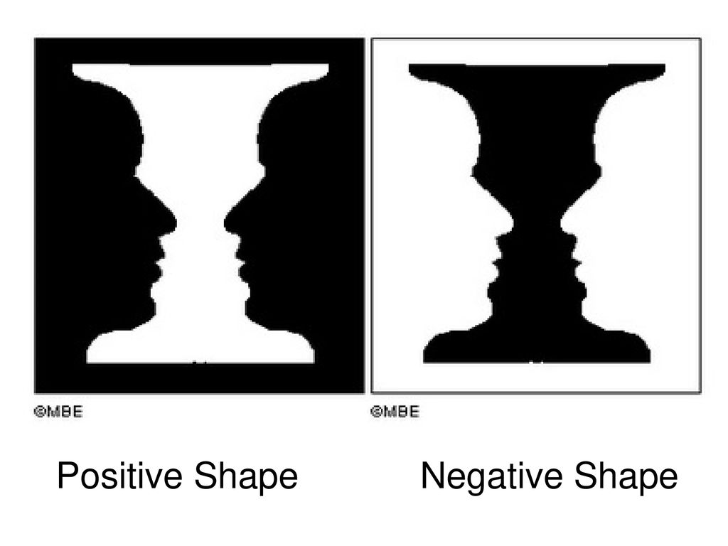
Positive and Negative Shapes

Slide 11
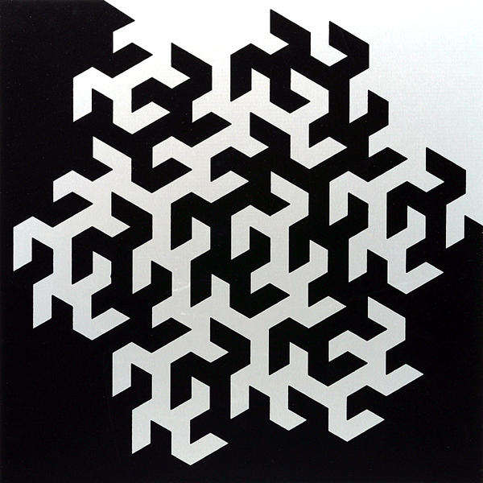
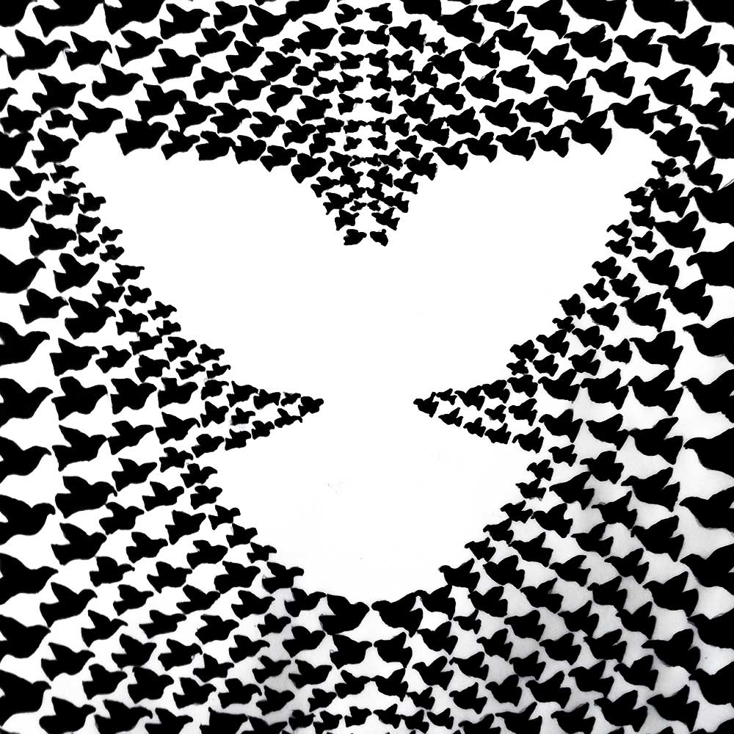
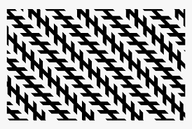
Positive and Negative Shapes

Slide 12
Implied Shapes

Slide 13
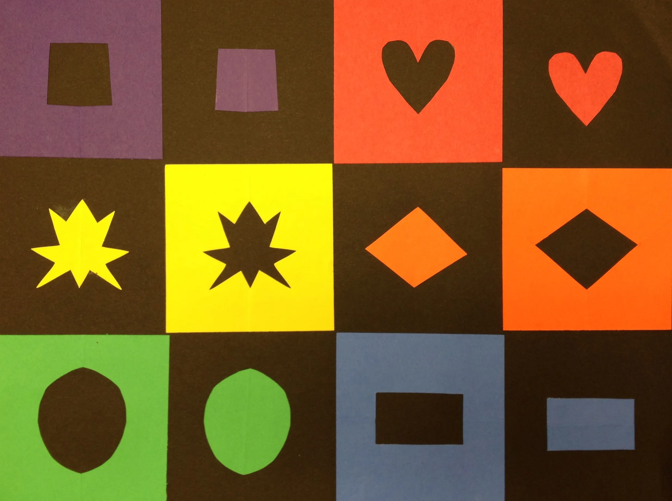
Positive and Negative Shapes
https://www.youtube.com/watch?v=Yvw16zFVBkQ

