Slide 1
PRINCIPLES OF DESIGN: movement, variety, & unity
By: mr. bush

Slide 2
What is movement?
The path the viewer’s eye takes through the work of art.

Slide 3
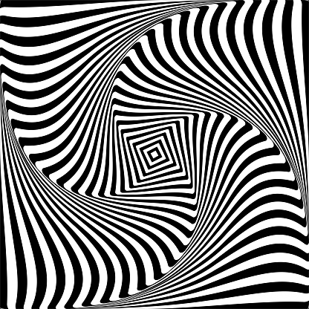
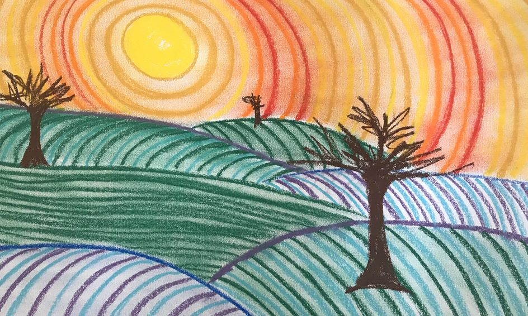
What is movement?

Slide 4
What is variety?
The use of several elements of art to hold the viewer’s attention and to guide the viewer’s eye through and around the work.

Slide 5
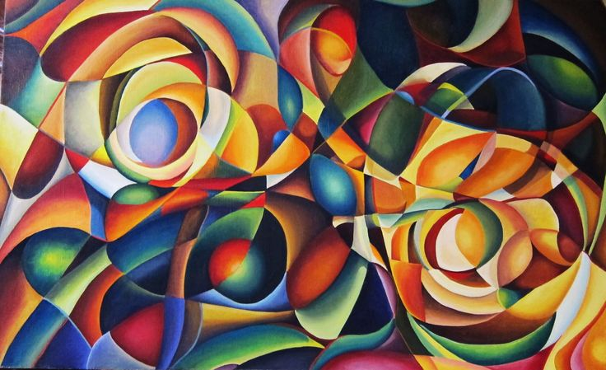
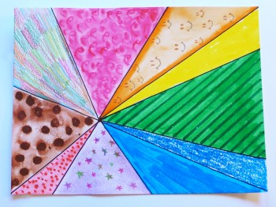
What is variety?

Slide 6
What is unity?
The feeling of harmony between all parts of the work of art, which creates a sense of completion.

Slide 7
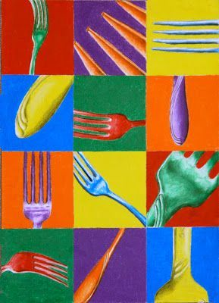
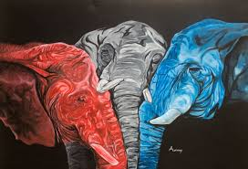
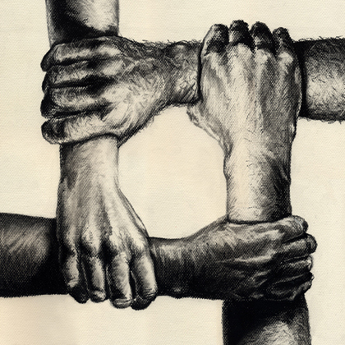
What is unity?

