Slide 1
Elements of Art: Form
By: Mr. Bush

Slide 2
What is Form?
Three-dimensional objects that can be measured by length, width, AND depth (e.g., spheres, cylinders, cubes, pyramids, cuboids, etc.).

Slide 3
So is a Form like a Shape?
A form is a three-dimensional (3-D) figure — as opposed to a shape, which is two-dimensional (2-D), or flat.
Form takes up space in either a real or implied way.

Slide 4
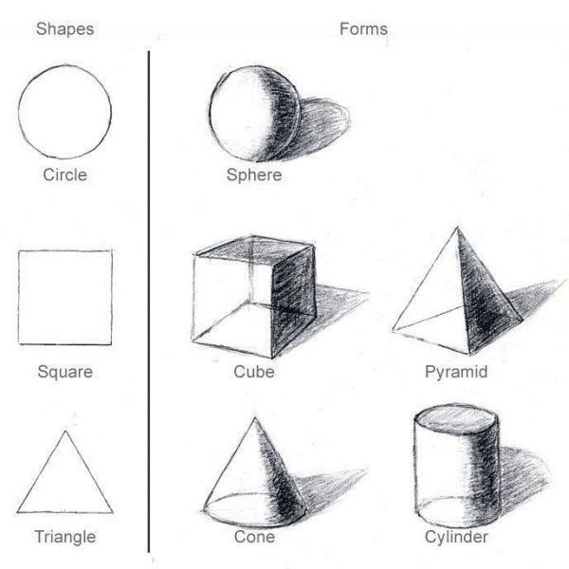
What is Form?

Slide 5
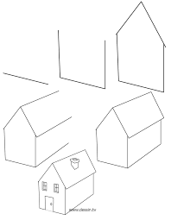
What is Form?

Slide 6
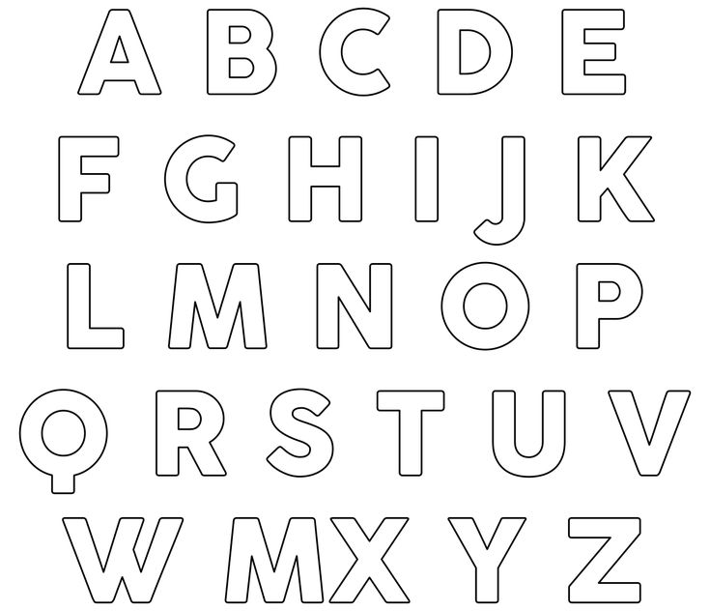
What else can be Forms?

Slide 7
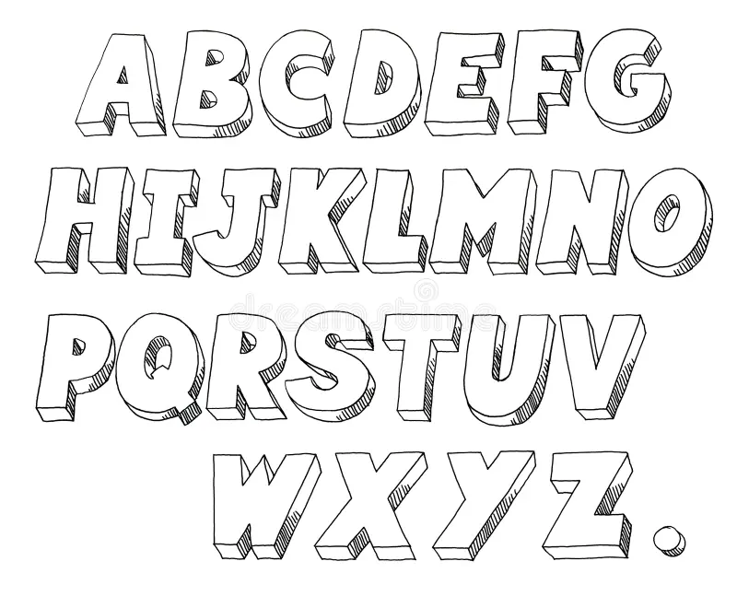
What else can be Forms?
ADD DEPTH/SIDES

Slide 8
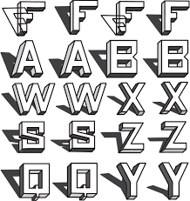
What else can be Forms?
ADD SHADOWS

Slide 9
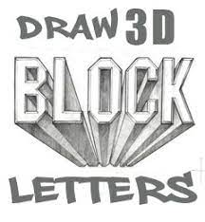
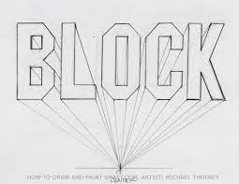
ADD PERSPECTIVE

Slide 10
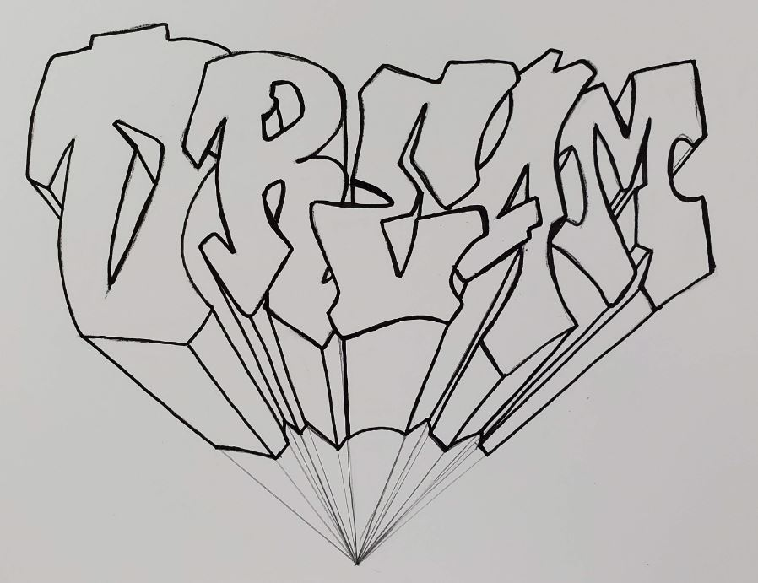
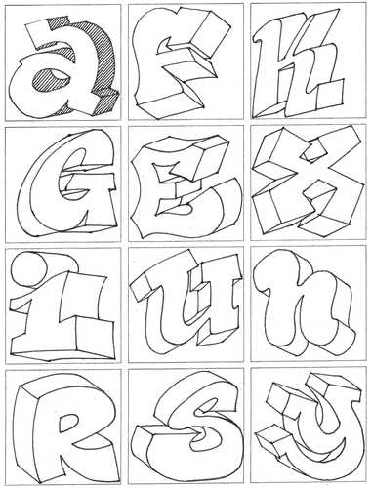
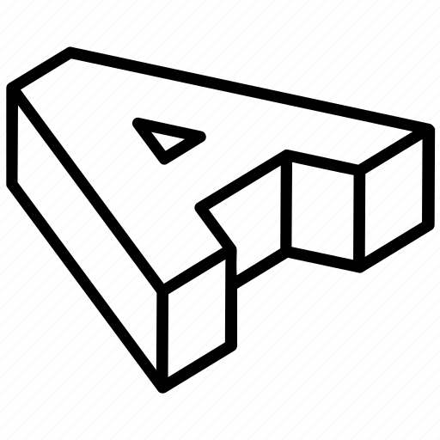

Slide 11
