Slide 1
Contrast, EMPHASIS, and Proportion
Principles of Design:
By: Mr. Bush

Slide 2
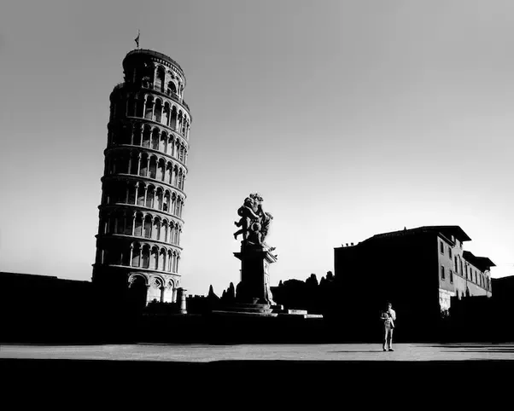
Contrast
The difference between elements of art in a composition, such that each element is made stronger in relation to the other.

Slide 3
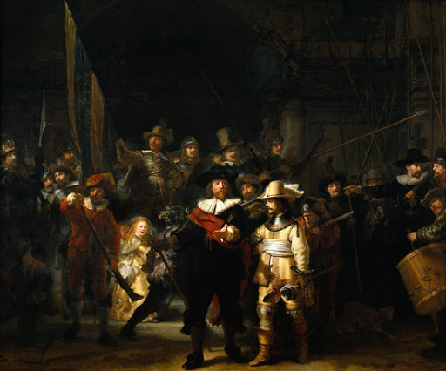
Emphasis
The part of the design that catches the viewer’s attention, also referred to as the center of interest or focal point.

Slide 4
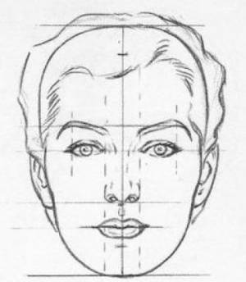
Proportion
The relationship of one part of a whole to other parts.

