Slide 1
Elements of art: color
BY: MR. BUSH

Slide 2
So what “is” color?
The quality of an object or substance with respect to the light reflected by the object. Color has three main characteristics: hue, value, and intensity.

Slide 3
The color wheel
The color wheel is a chart for identifying the 3 Primary colors (red, blue, and yellow), the 3 Secondary colors (orange, green, and purple), and sometimes the Tertiary colors (blue-green, red-orange, yellow-green, etc.).

Slide 4
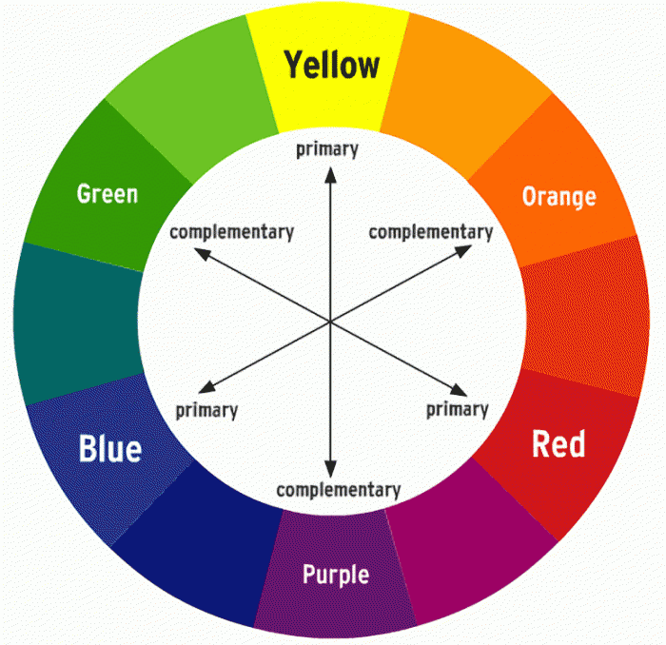
The color wheel

Slide 5
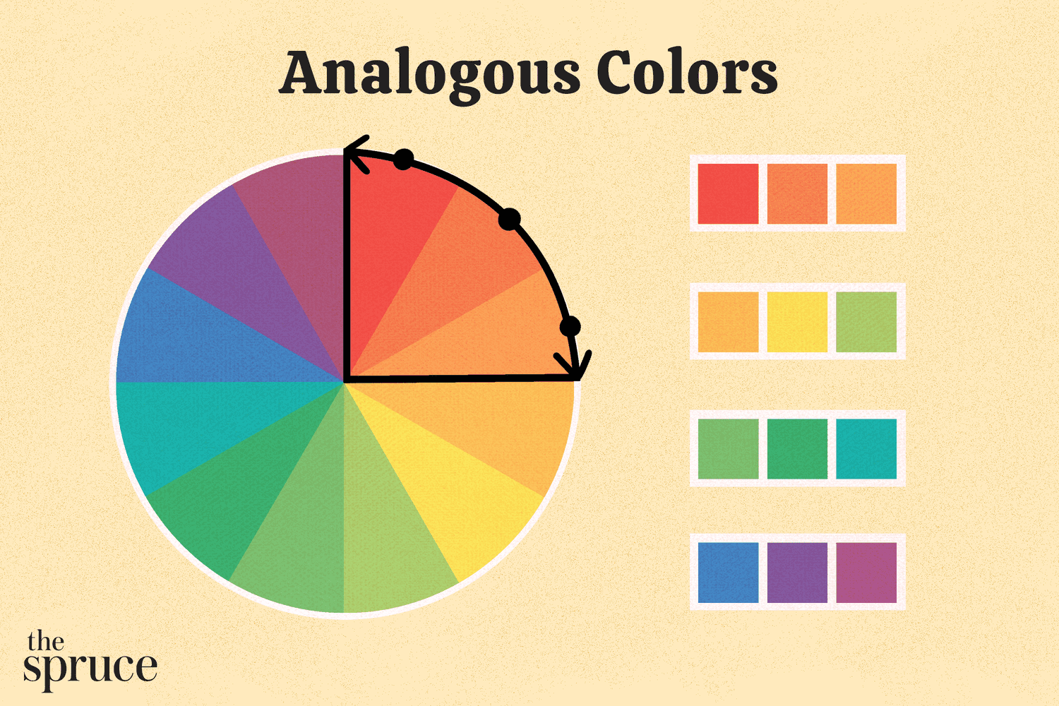
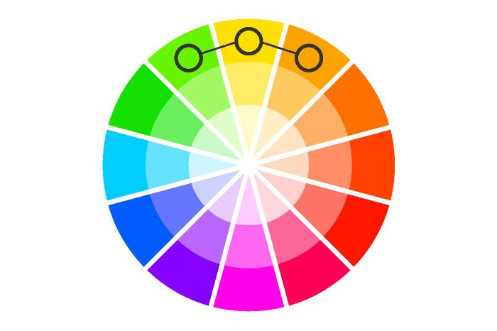
The color wheel
Neighbors on the Color Wheel

Slide 6
The 3 characteristics
Color has three main characteristics:
Hue
Value
Intensity.

Slide 7
Ok… So what is hue?
Color is a more general term while hue refers to a dominant color’s family among the six Primary and Secondary colors .
White, Black and Gray are often referred to as a color.
White, Black and Gray are NEVER referred to as a Hue.

Slide 8
Ok… So what is hue?
Burgundy = RED hue
Maroon = RED hue
Navy = BLUE hue
Rust = ORANGE hue
Cool Gray = It might be BLUE or even PURPLE or GREEN (Really look at it.)
Warm Brown = It might be ORANGE but it might be RED or YELLOW (Really look at it.)

Slide 9
Ok… So what is value?
The degree of lightness or darkness of a tone or color. Value is dependent upon the amount of light a surface reflects.

Slide 10
Ok… So what is intensity?
(also referred to as saturation or chroma) refers to the degree of purity of a color. A highly intense color is bright and a low-intensity color is more neutral or muted.
Value is the “lightness or darkness” of a hue and it is changed by adding black or white to a color. Intensity is the “brightness or dullness” of hue and is changed by mixing a color with its complement (the color directly across from it on the color wheel).

Slide 11
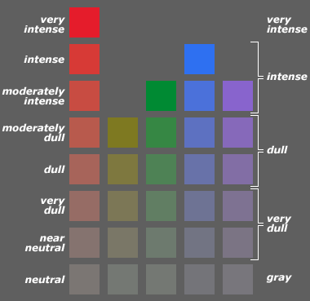
Ok… So what is intensity?

