Slide 1
Repetition, Rhythm, & Pattern
PRINCIPLES OF DESIGN:
By: Mr. Bush

Slide 2
WHAT IS REPETITION?
Works with pattern to make the work of art seem active. The repetition of elements of art creates unity within the work of art.

Slide 3
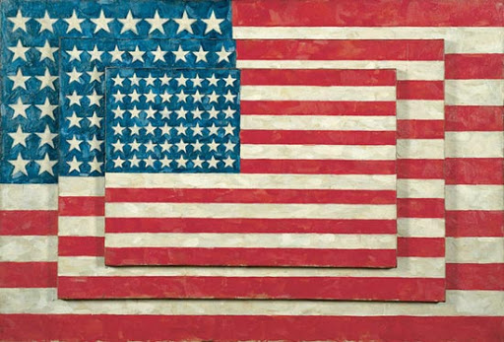
WHAT IS REPETITION?

Slide 4
WHAT IS PATTERN?
The repeating of an object or symbol CONSISTENTLY throughout the work of art.

Slide 5
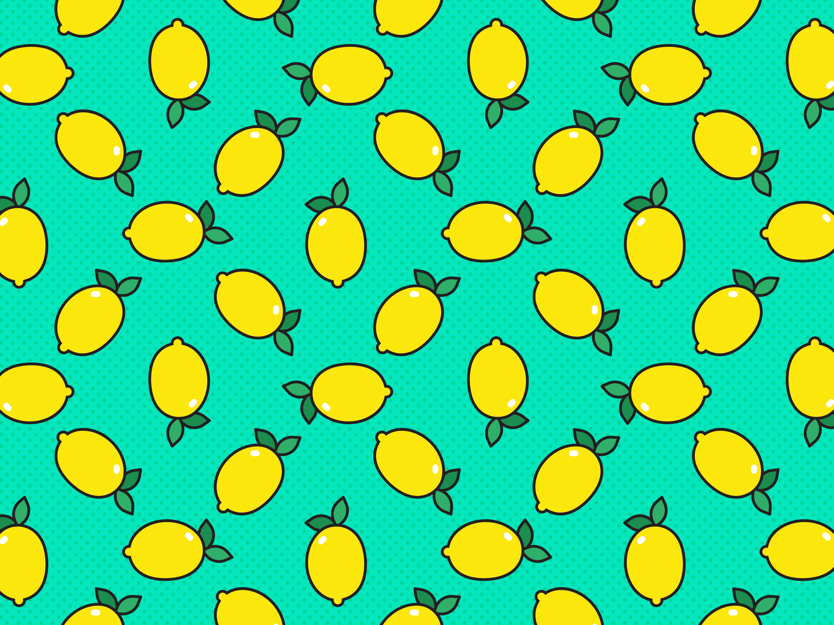
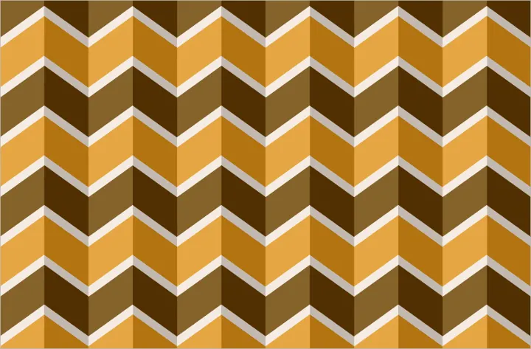
WHAT IS PATTERN?

Slide 6
WHAT IS RHYTHM?
Created when one or more elements of art are used repeatedly to create a feeling of organized movement. Rhythm creates a mood like music or dancing. Unlike pattern, which demands consistency, rhythm relies on variety.

Slide 7
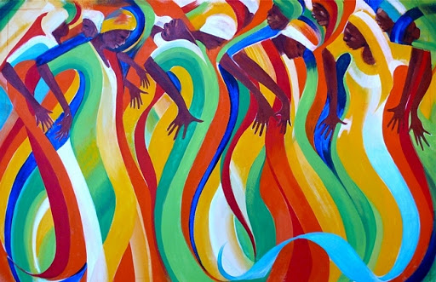
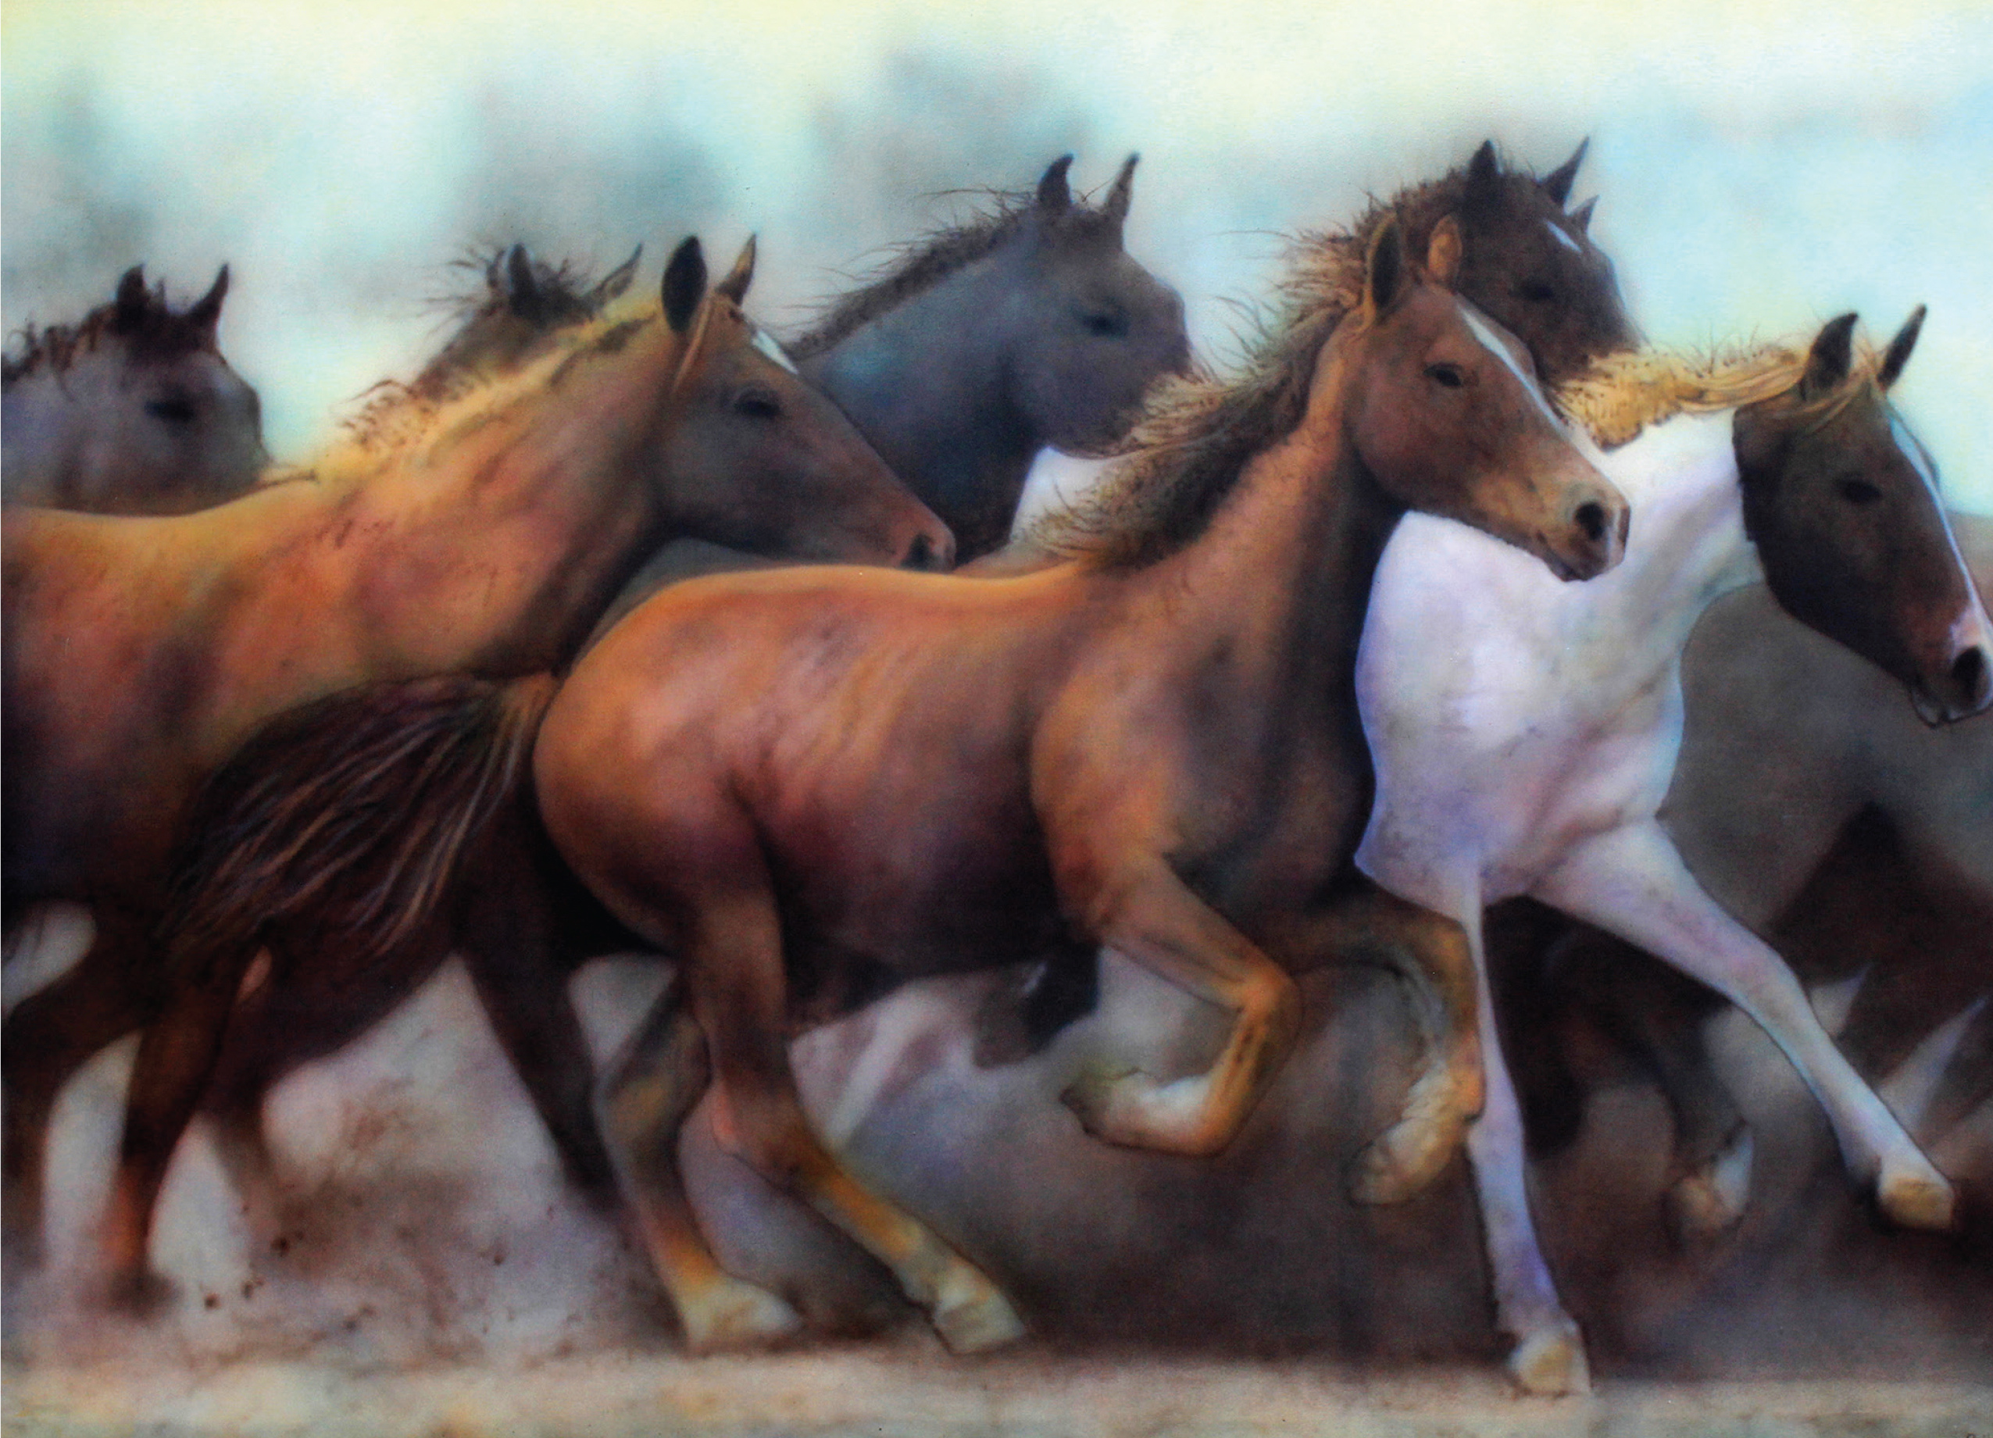
WHAT IS RHYTHM?

