Slide 1
Elements of art: line
By: Mr. Bush

Slide 2
What is a line?
A line is probably the most fundamental of all the elements of art and design. Line is the path of a dot, point etc. through space, and usually has more length than thickness. It is the starting point for most artistic creation whether one is starting a fine drawing, painting, sketching ideas for a sculpture, or even designing architecture. Most design begins with a single line or many.

Slide 3
What are some types of lines?
Vertical lines: are straight up and down.
Horizontal lines: are left and right.
Diagonal lines: are lines that straight in any direction except vertical or horizontal.
Zig-Zag lines: are a series of diagonal lines joined end to end.
Curved lines: are lines that bend in any amount of degree; they may be slightly round or even spirals.

Slide 4
Ways artists use line
to create a border around their art
to outline; a starting place for many drawings or paintings
to suggest moods or emotion; lines can appear calm, nervous, angry, etc.
to lead the viewers eye through a work of art
to create lightness or darkness; lines placed close together appear darker than those placed further from each other
to create texture; roughness or smoothness

Slide 5
Common types of line design
contour line drawing; drawings that use a fairly continuous line to represent the edges and surface detail of shape or objects being drawn
gestural line drawing; drawings that use quick pencil strokes (or other drawing instruments) to capture a scene. gestural drawings imply action and movement
hatched and cross hatched line drawing; drawings that consist of parallel lines (hatching) or crossing parallel lines (cross-hatching) drawn to create changes in lightness and darkness and texture.
Implied line; refer to the path that the viewer's eye takes as it follows shape, color, and form

Slide 6
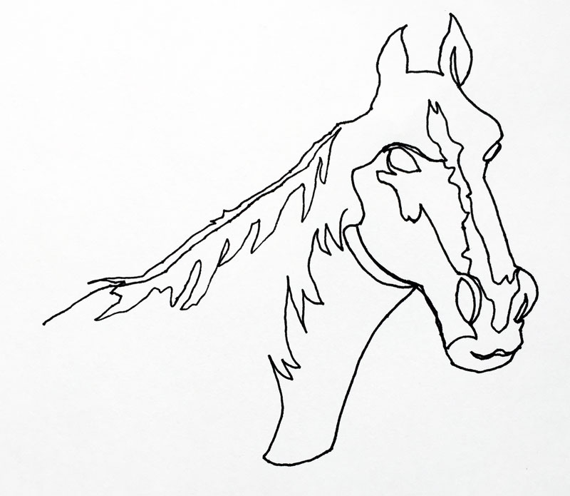
Contour line

Slide 7
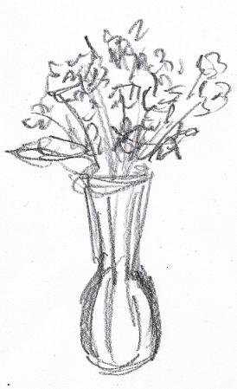
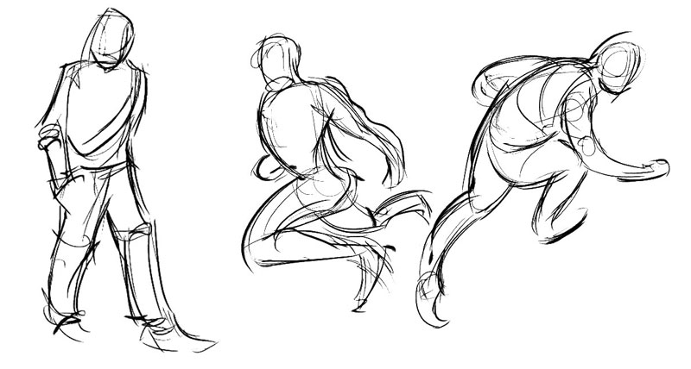
gestural line

Slide 8
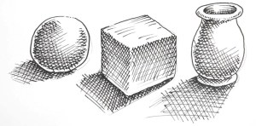
Hatching & cross hatching

Slide 9
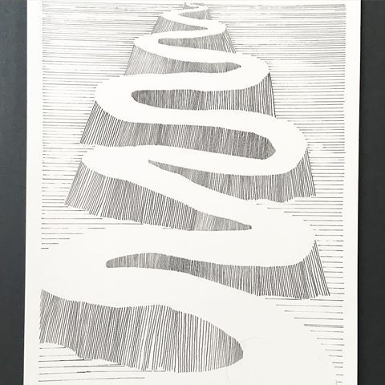
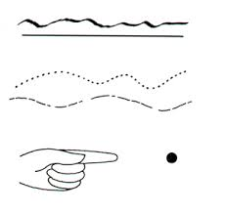
Implied line

Slide 10
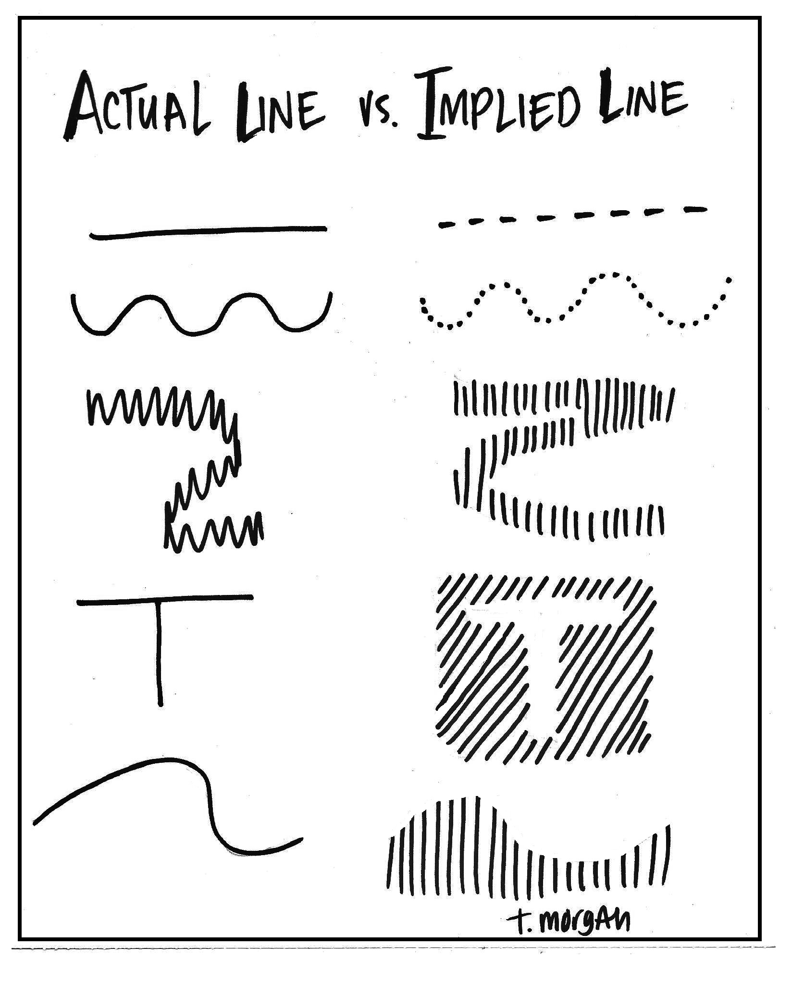
Think of a hinted path from one point to another.

Slide 11
Line design in life

Slide 12
Line design in life

Slide 13
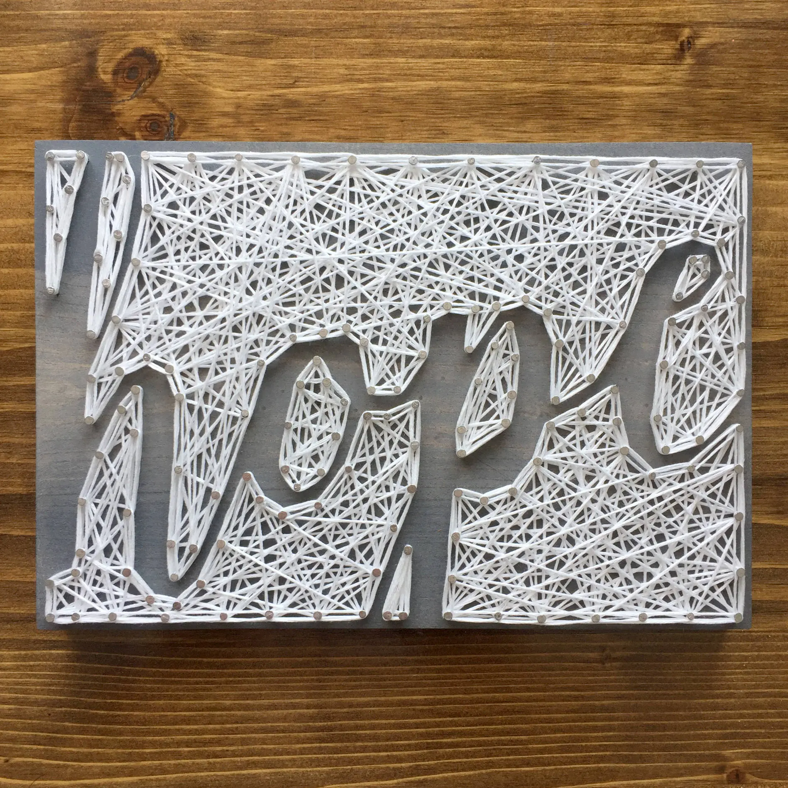
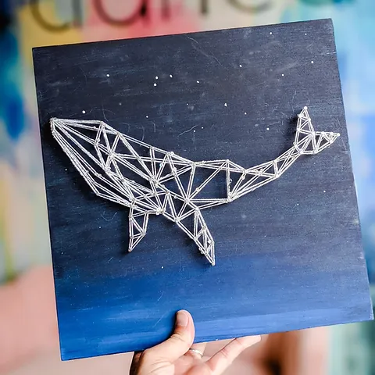
Line design in life

Slide 14
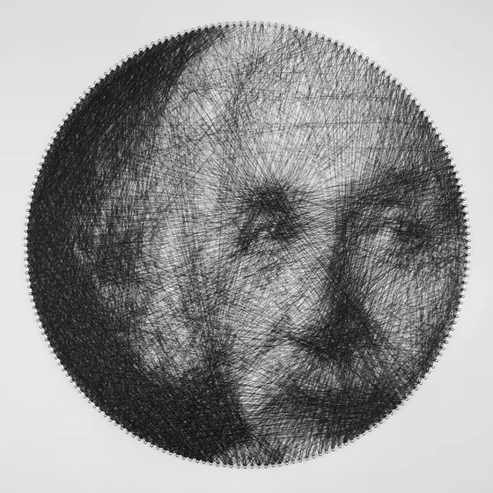
Line design in life

Slide 15
Line design in life

Slide 16
Line design in life

Slide 17
Line design in life

Slide 18
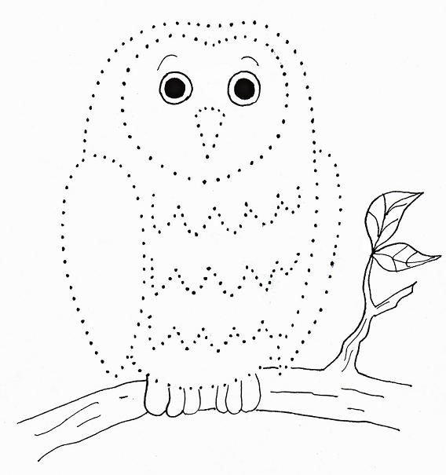
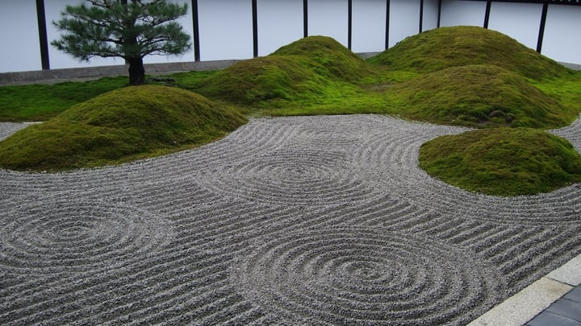
Line design in life

Slide 19
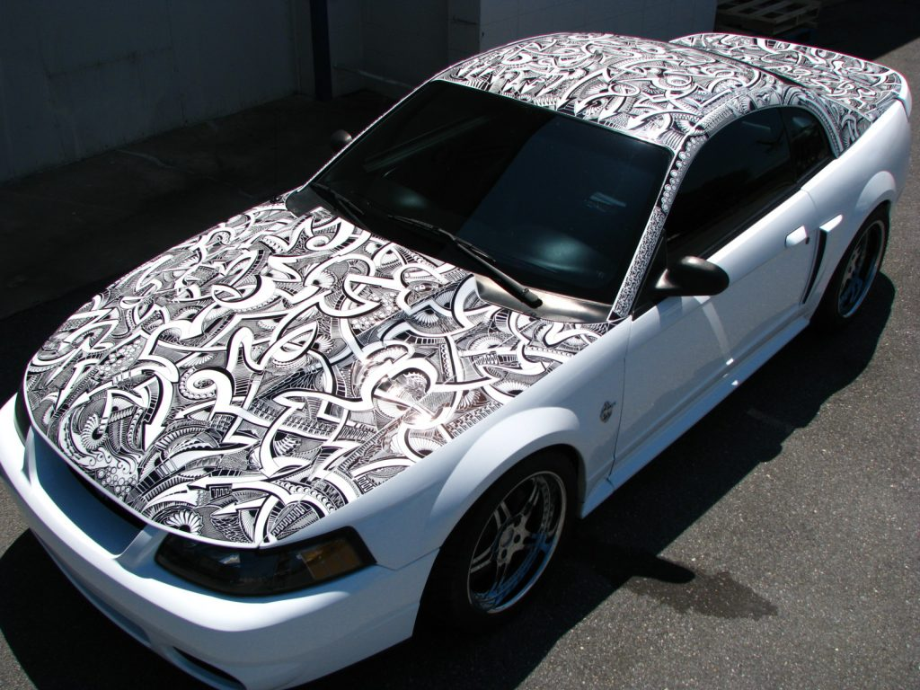
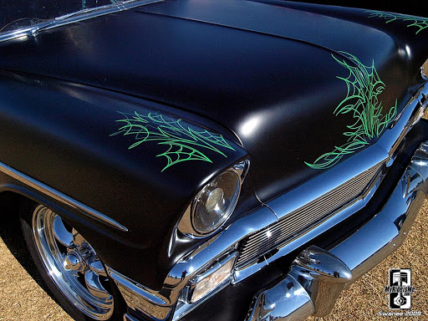
Line design in life

Slide 20
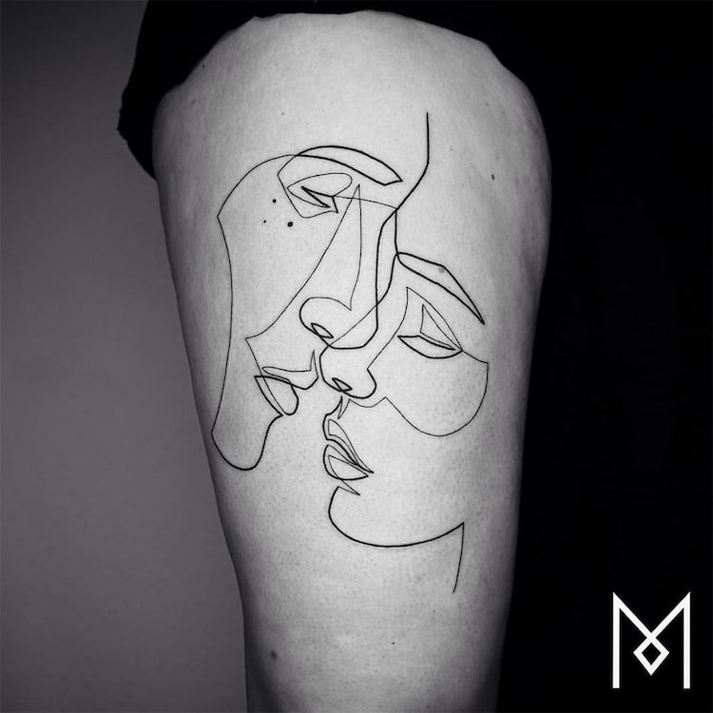
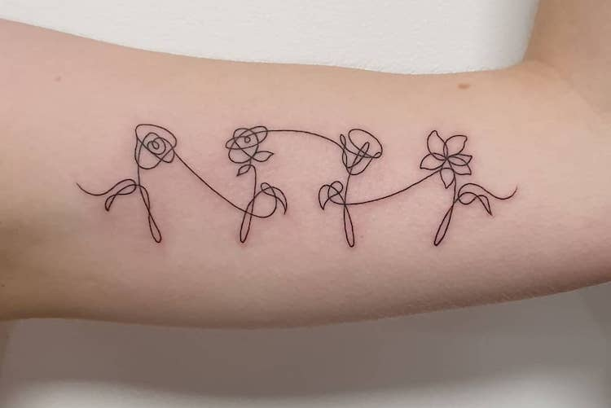
Line design in life

Slide 21
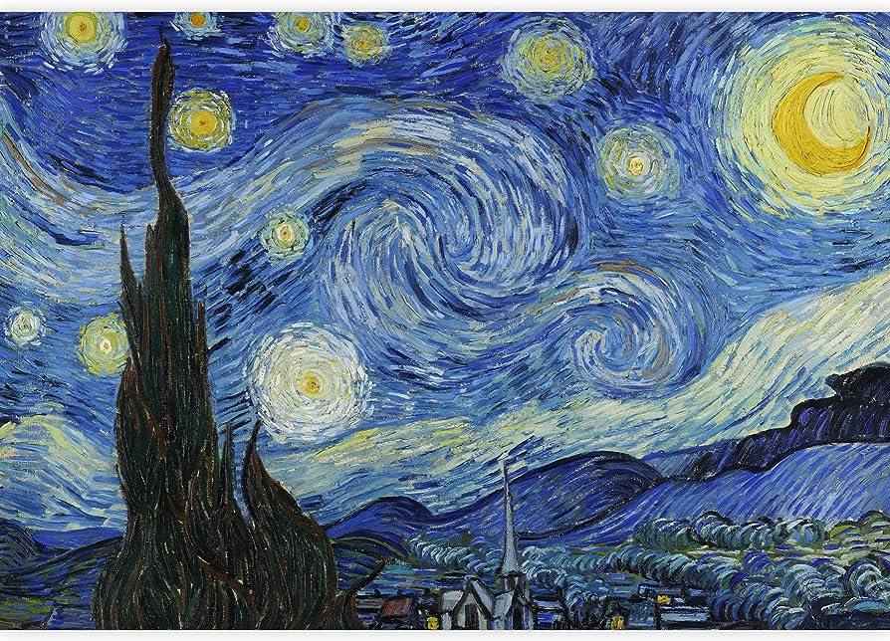
Line design in life

Slide 22
Line design in life

