Slide 1
Appropriation, Copyright, & fair use
By: Mr. Bush

Slide 2
Appropriation
Intentional borrowing, copying, and alteration of preexisting images and objects.

Slide 3
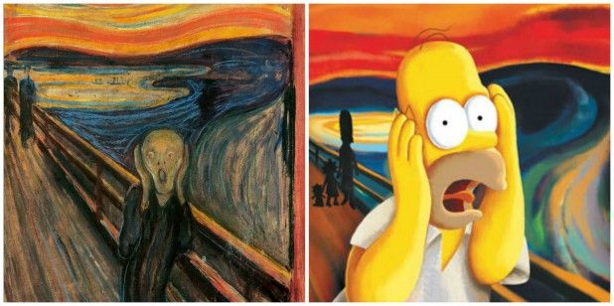
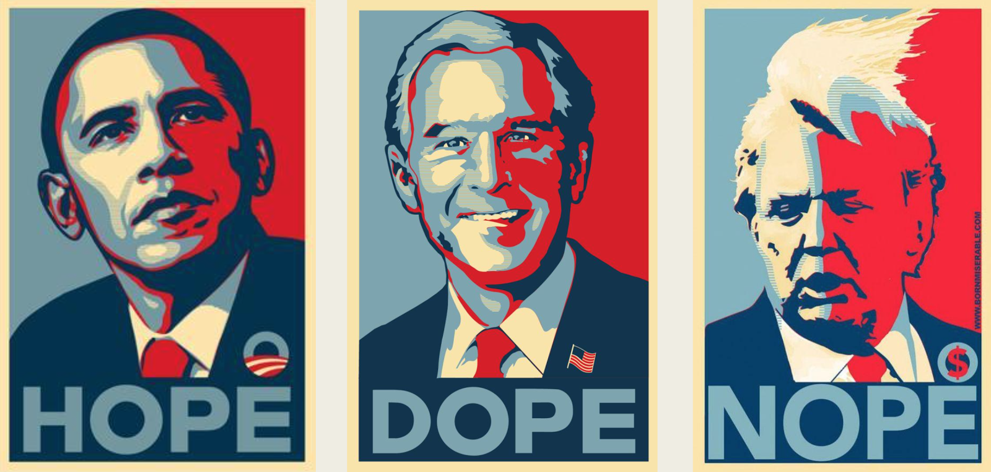
Why do artists use Appropriation?
They hope that the viewer will bring all of his original associations with the image to the artist's new context.

Slide 4
Copyright
Form of protection grounded in the U.S. Constitution and granted by law for original works of authorship fixed in a tangible medium of expression, covering both published and unpublished works.

Slide 5
How do I get a Copyright?
A work is protected by copyright the moment the work is fixed in a tangible (touchable) medium of expression – so a painting is protected the moment it’s painted, and a novel is protected the moment it’s written down on a laptop.

Slide 6
What can be Copyrighted?
The rule is that, for a work to be copyrightable, it must be original, and it must be fixed “in a tangible (touchable) medium of expression.”

Slide 7
Fair Use
The doctrine that brief excerpts of copyright material may, under certain circumstances, be quoted verbatim for purposes such as criticism, news reporting, teaching, and research, without the need for permission from or payment to the copyright holder.

